Slide 1
Ergonomics and Human Factors
Work Systems and the Methods, Measurement, and Management of Work
by Mikell P. Groover, ISBN 0-13-140650-7.
©2007 Pearson Education, Inc., Upper Saddle River, NJ. All rights reserved.

Slide 2
Introduction to Ergonomics
and Human Factors
Sections:
Overview of Ergonomics
Human-Machine Systems
Topic Areas in Ergonomics
Work Systems and the Methods, Measurement, and Management of Work
by Mikell P. Groover, ISBN 0-13-140650-7.
©2007 Pearson Education, Inc., Upper Saddle River, NJ. All rights reserved.

Slide 3
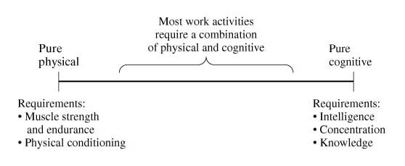
Physical and Cognitive Demands
Most work activities require a combination of physical and cognitive exertions
Shoveling
Translation
Work Systems and the Methods, Measurement, and Management of Work
by Mikell P. Groover, ISBN 0-13-140650-7.
©2007 Pearson Education, Inc., Upper Saddle River, NJ. All rights reserved.

Slide 4
Ergonomics
An applied scientific discipline concerned with how humans interact with the tools and equipment they use while performing tasks and other activities
Derived from the Greek words ergon, meaning work, and nomos, meaning laws
The word ergonomics was coined by British scientist K. F. H. Murrell and entered the English language in 1949
Earlier applications in “fitting man to the job” (1900’s)
  Choose from the pool of job applicants who were best suited to the requirements (psychological tests)
Hawthorne experiments (1920’s)
  Importance of social factors in work
Work Systems and the Methods, Measurement, and Management of Work
by Mikell P. Groover, ISBN 0-13-140650-7.
©2007 Pearson Education, Inc., Upper Saddle River, NJ. All rights reserved.

Slide 5
Human Factors
Human factors is synonymous with ergonomics
Ergonomics emphasizes work physiology and anthropometry (individual at work)
  Europe – industrial work systems
Human factors emphasizes experimental psychology and systems engineering (the human element in a system)
  U.S. – military work systems
Work Systems and the Methods, Measurement, and Management of Work
by Mikell P. Groover, ISBN 0-13-140650-7.
©2007 Pearson Education, Inc., Upper Saddle River, NJ. All rights reserved.

Slide 6
History of Ergonomics
Taylor – scientific management movement
  Critics against Taylorism
Frank and Lillian Gilbert- human factors
Early 1900s: “fitting the man to the job”
Late 1920s: The Hawthorne experiments – social factors in the workplace- “human relations” research
1900-1945: growth of use of machinery and mechanization
End of WW II: Increased complexity of equipment – human-machine systems
K.F.H. Murrel: the term ergonomics – emphasis on industrial work systems
1950: Ergonomics Research Society (UK)
1957: The Human Factors Society (US)
1960: consumer products and working class impact politically
1980 - current:
  Advances in computer and automation technologies
  Disasters: critical importance of human in the operation of human-machine systems

Slide 7
From www.ergonomics.org.uk
1949
July - "Ten scientists of differing background, but all interested in the study of human work, decided to form a group to enable research workers in different disciplines to meet and exchange ideas. They called themselves the "Human Research Society"" (K.F.H. Murrell, BPS Bulletin, No.22, January 1954).
Summer - "Ergonomics" defined by Murrell after consultation with Greek and Latin Scholars as "the study of the relationship between man and his working environment".
Autumn - meeting held in Oxford which decided to turn the group into a Society
27th September - Ergonomics Research Society formed - Queen Anne’s, Admiralty, London.
Work Systems and the Methods, Measurement, and Management of Work
by Mikell P. Groover, ISBN 0-13-140650-7.
©2007 Pearson Education, Inc., Upper Saddle River, NJ. All rights reserved.

Slide 8
Objectives in Ergonomics
  Main objective: to improve the performance of systems consisting of people and equipment.
  Human-machine systems
    Machine: a variety of objects – aircraft, appliances, automobiles, chairs, computers, hand tools, sports equipment
  “using knowledge of human abilities and limitations to design and build for comfort, efficiency, productivity and safety” – The Ergonomics Society
Work Systems and the Methods, Measurement, and Management of Work
by Mikell P. Groover, ISBN 0-13-140650-7.
©2007 Pearson Education, Inc., Upper Saddle River, NJ. All rights reserved.

Slide 9
Objectives in Ergonomics
  Greater ease of interaction between user and machine
  Avoid errors and mistakes
  Greater comfort and satisfaction in use of the equipment
  Reduce stress and fatigue
  Greater efficiency and productivity
  Safer operation
  Avoid accidents and injuries
Work Systems and the Methods, Measurement, and Management of Work
by Mikell P. Groover, ISBN 0-13-140650-7.
©2007 Pearson Education, Inc., Upper Saddle River, NJ. All rights reserved.

Slide 10
Methods Engineering vs. Ergonomics
Closely related and their general objectives are the same:
To improve the performance of existing systems
To design new systems for optimum performance
Work Systems and the Methods, Measurement, and Management of Work
by Mikell P. Groover, ISBN 0-13-140650-7.
©2007 Pearson Education, Inc., Upper Saddle River, NJ. All rights reserved.

Slide 11
Methods Engineering vs. Ergonomics
Emphasis in Methods Engineering
Efficiency
Cost reduction
Labor reduction
Workplace layout
“One best way”
Facility layout
Elimination of waste
Emphasis in Ergonomics and Human Factors
Safety
Comfort
Interaction between human and equipment
Workplace environment
Fitting the work to the individual
Reduction of human errors
Accident avoidance
Work Systems and the Methods, Measurement, and Management of Work
by Mikell P. Groover, ISBN 0-13-140650-7.
©2007 Pearson Education, Inc., Upper Saddle River, NJ. All rights reserved.

Slide 12
Ergonomics Application Areas
Work system design: interaction between worker and the equipment used in the workplace
  Objectives: safety, accident avoidance, improved functional performance
  Also includes environment such as lighting
Product design
  Objectives: safety, comfort, user-friendly, mistake proof
Our focus: work systems (which in fact overlap with the product design)
Work Systems and the Methods, Measurement, and Management of Work
by Mikell P. Groover, ISBN 0-13-140650-7.
©2007 Pearson Education, Inc., Upper Saddle River, NJ. All rights reserved.

Slide 13
Ergonomists – What They Do
Research on human capabilities and limitations
  Discover the characteristics of human performance, e.g., how much can an average worker lift?
Design and engineering applications
  Use the research findings to design better tools and work methods
Work Systems and the Methods, Measurement, and Management of Work
by Mikell P. Groover, ISBN 0-13-140650-7.
©2007 Pearson Education, Inc., Upper Saddle River, NJ. All rights reserved.

Slide 14
Fitting the Person to the Job (FPJ)
Common philosophy prior to ergonomics
Considers worker’s physical and mental aptitudes (skills) in employment decisions
  Psychometric testing (e.g., tests for intelligence and personality characteristics)
  For example, using worker size and strength as criteria for physical work
FPJ is still important
  For example, educational requirements for technical positions
Work Systems and the Methods, Measurement, and Management of Work
by Mikell P. Groover, ISBN 0-13-140650-7.
©2007 Pearson Education, Inc., Upper Saddle River, NJ. All rights reserved.

Slide 15
Fitting the Job to the Person (FJP)
It is the approach that ergonomics follow and opposite of FPJ
Philosophy: design the job so that any member of the work force can perform it
Why the FJP philosophy has evolved:
  Changes in worker skill requirements
    Today, companies do not need to be much selective, since workers are much more educated. In stead of investing time in selection procedure, companies spend time to train the new workforce
  Demographic changes (e.g. more women in the workforce, recruiting fewer people of young age)
  Social and political changes (e.g., equal opportunity laws, trade unions, collective bargaining)
    Hiring handicapped workers is encouraged by the laws.
Work Systems and the Methods, Measurement, and Management of Work
by Mikell P. Groover, ISBN 0-13-140650-7.
©2007 Pearson Education, Inc., Upper Saddle River, NJ. All rights reserved.

Slide 16
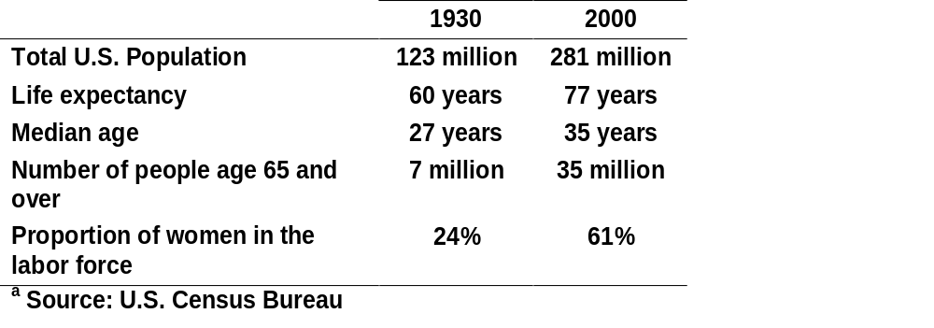
Changes: 1930 and 2000
Work Systems and the Methods, Measurement, and Management of Work
by Mikell P. Groover, ISBN 0-13-140650-7.
©2007 Pearson Education, Inc., Upper Saddle River, NJ. All rights reserved.

Slide 17
Human-Machine Systems
Basic model in ergonomics
Defined as a combination of humans and equipment interacting to achieve some desired result – ref. Chp. 2 (e.g. external vs. internal work elements, levels of operator attention)
Types of human-machine systems:
  Manual systems: a person using some (nonpowered) tool
  Mechanical systems: one or more humans using powered equipment
  Automated systems: automated system requiring occasional human attention
Work Systems and the Methods, Measurement, and Management of Work
by Mikell P. Groover, ISBN 0-13-140650-7.
©2007 Pearson Education, Inc., Upper Saddle River, NJ. All rights reserved.

Slide 18
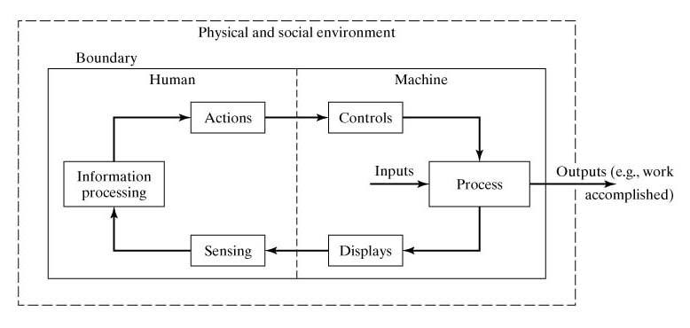
Human-Machine Interactions
A human-machine system has boundaries, that define what components are included within the scope of the system.
A worker-machine production cell is one component in the larger production department.
The ergonomist must decide where to draw the boundaries of the human-machine system of interest.

Slide 19
System Components
Setting the boundary matters because
  it identifies controllable / uncontrollable
  it reflects what the human -machine system operation is assumed to be
The human
The equipment
The environment (both physical and social)
  Poor lighting may effect worker’s ability to perform an inspection task
  An unfriendly supervisor may reduce a worker’s motivation to work.
Work Systems and the Methods, Measurement, and Management of Work
by Mikell P. Groover, ISBN 0-13-140650-7.
©2007 Pearson Education, Inc., Upper Saddle River, NJ. All rights reserved.

Slide 20
Human Components
Functions: (1) sensing the operation, (2) information processing, (3) actions
  Human senses - to sense the operation
    Five basic human sense (vision, hearing, touch, taste, and smell)
    Related with sensory (+ nerveous) system of the body
  Human brain - for information processing by the stimuli received from the senses
    Thinking, planning, calculating, making decisions, solving problems
    Related with the brain
  Human effectors - to take action by the impulses from the nervous system
    Fingers, hands, feet, and voice
    Related with the musculoskeletal system (+ nerveous) system of the body.
Work Systems and the Methods, Measurement, and Management of Work
by Mikell P. Groover, ISBN 0-13-140650-7.
©2007 Pearson Education, Inc., Upper Saddle River, NJ. All rights reserved.

Slide 21
Machine Components
The machine in a human machine-system can range from a simple hand tool to a complex and sophisticated system of equipment.
The process – function or operation performed by human-machine system
Displays - to observe the process
  Direct observation for simple processes
  Artificial displays for complex processes (speedometer in a car)
Controls - to actuate and regulate the process
  Steering wheel, computer keyboard
A worker using a shovel to dig a hole in the ground.
  Process: digging, Displays: direct observation (no need for displays), Controls: handle of the shovel
A worker monitoring the operation of an automated process. The worker should make sure that the process is within defined tolerances
  Process: process itself, Displays: a digital monitor, Controls: buttons, levers
Work Systems and the Methods, Measurement, and Management of Work
by Mikell P. Groover, ISBN 0-13-140650-7.
©2007 Pearson Education, Inc., Upper Saddle River, NJ. All rights reserved.

Slide 22
Environmental Components
Physical environment
  Location and surrounding lighting, noise, temperature, and humidity
Social environment
  Co-workers and colleagues at work
  Immediate supervisors
  Organizational culture
  Pace of work
Work Systems and the Methods, Measurement, and Management of Work
by Mikell P. Groover, ISBN 0-13-140650-7.
©2007 Pearson Education, Inc., Upper Saddle River, NJ. All rights reserved.

